Slide 1
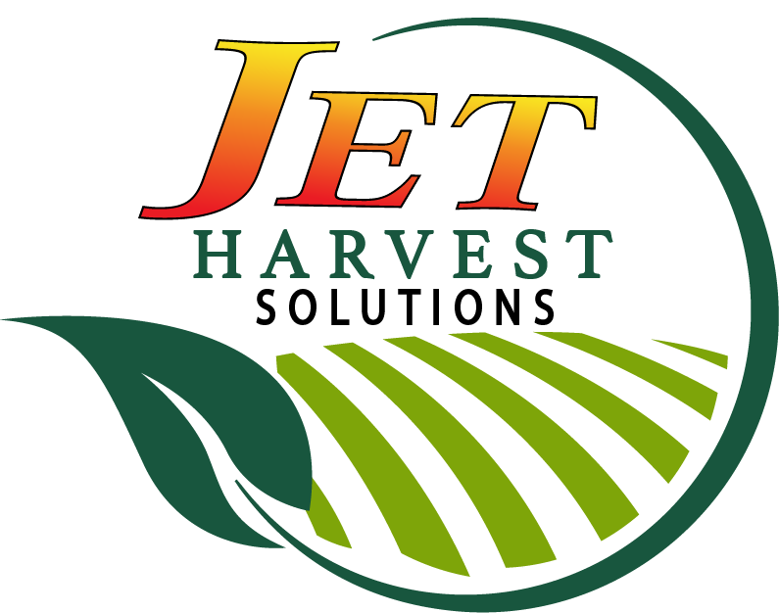
Jet Harvest Solutions
Bill & Lucie Grant – Owners
Matt Ohl – PNW Sales Mgr.

Slide 2
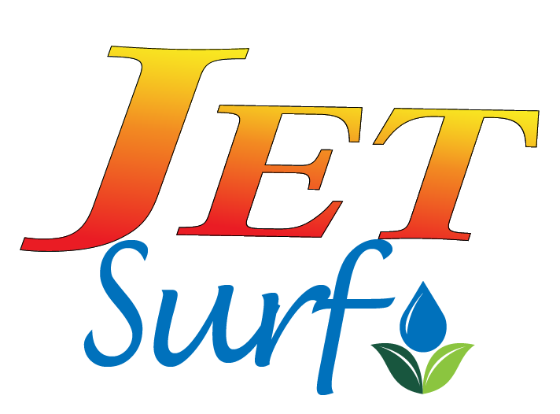
Jet-Surf was developed using cutting edge surfactant technology and input from leading vegetable growers.
Synergistic blend of powerful anionic (charged) surfactants that together dramatically enhance fungicides and pesticides used in fruit and vegetable crops.
Extensively tested both in the laboratory and in field trials. It has been observed that weekly use of Jet-Surf with a comprehensive spray program greatly reduced the incidences of diseases.

Slide 3
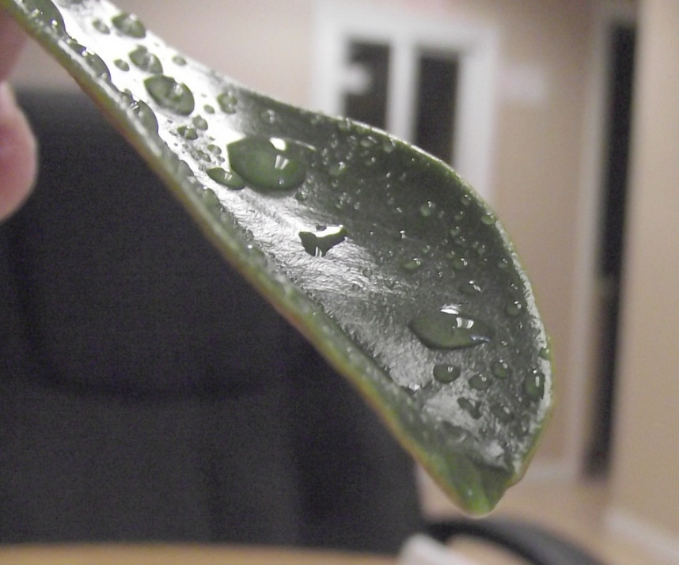
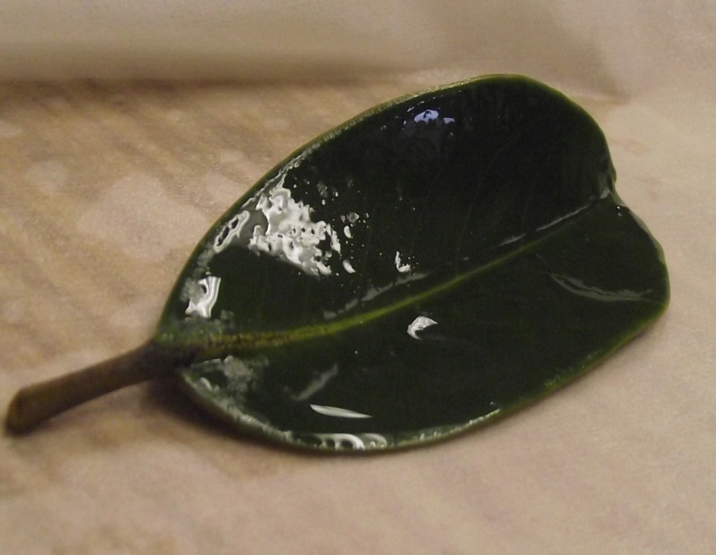
Surfactant: The word surfactant is short for Surface Acting Agent.
Surfactants reduce the surface tension of water. This helps liquids disperse
more evenly over surfaces including the surface of leaves of crops.
This improves the action of any fungicide/ pesticide because of the better
distribution of chemicals.
Water only
With Jet-Surf

Slide 4
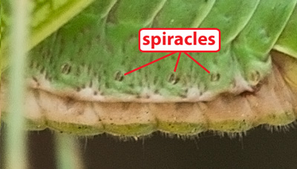
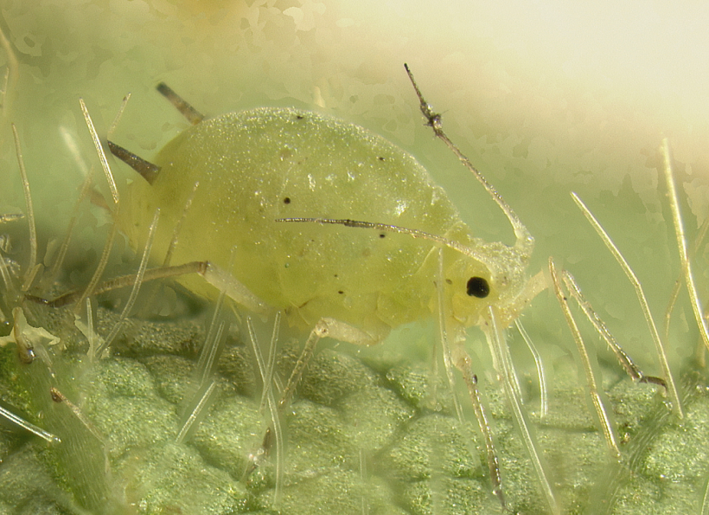
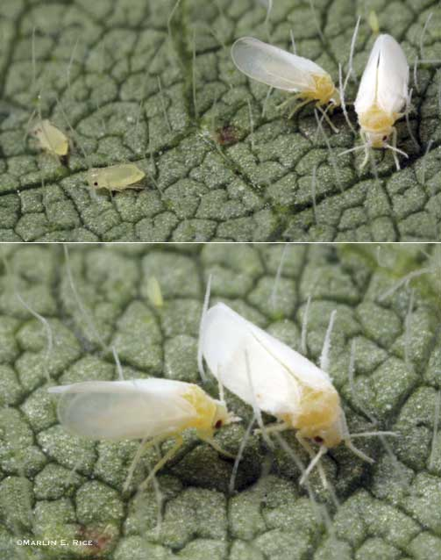
Surfactants also break down the exoskeleton of soft bodied insects
and reduce the surface tension of water allowing pesticides and water into the
spiracles causing suffocation and death. Allowing for less pesticide usage.
Thrips
Aphids
Whitefly

Slide 5
Reducing the surface tension below 30 dyn/cm of a liquid allows spray mixtures to enter the stomas of the leaves. (Jet-Surf has tested to have about 28 dyn/cm at recommended dilutions.)This is beneficial because it aids in absorption of crop production chemicals. However there has been some evidence that surfactants that have no efficacy against bacteria and fungi can actually spread disease when not used with Bactericides/Fungicides.
Jet-Surf has been shown to have antimicrobial properties alone and much less likely to spread disease pathogens than other non-ionic and silicone based surfactants (like Wet-Cit).

Slide 6
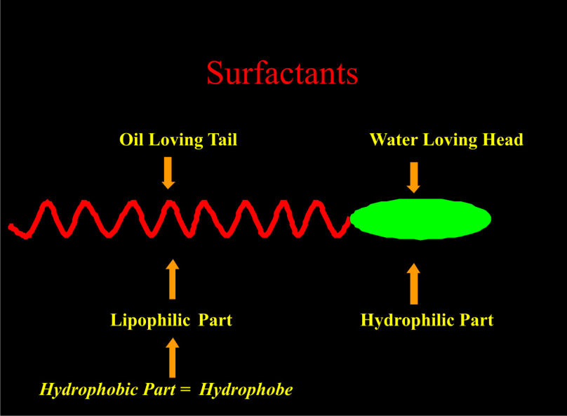
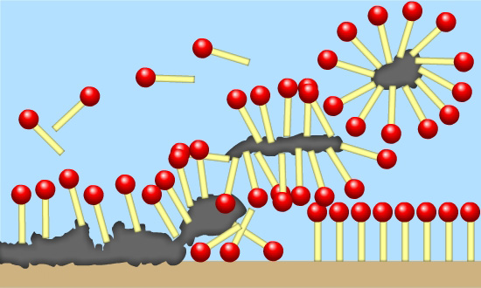
In addition to wetting or water dispersing properties , Jet-Surf’s proprietary blend of Anionic Surfactants’ molecular structure allows them to interact with dirt, oils, and proteins solubilizing or “emulsifying them” thus removing it from surfaces including fruits and vegetables.

Slide 7
Jet-Surf disrupts the biological lipid membranes of bacteria, fungi and some viruses.
Allows for better coverage on crops by decreasing the surface tension of water.
Helps insecticides work better by helping the pesticide enter the vascular system of the insect.

Slide 8
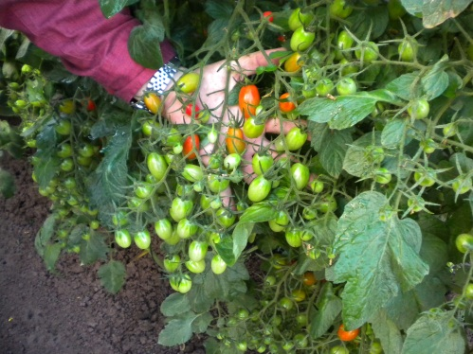
All ingredients in compliance with:40 CFR 180.910 (EPA), 40 CFR 180.920 (EPA),40 CFR 180.940 (EPA), and 21 CFR 173.315 (FDA)
Safe and effective way to help enhance pest/disease control,
extend shelf life of harvested produce.
Readily Biodegradable &
Environmentally friendly
Extensively tested on several crops, and shown to be a powerful tool to keep bacterial and fungal diseases under control.
Registered in Washington

Slide 9
Jet-Surf:
Help control Disease and insects in the field.
Help improve coverage of the leaves so that the fungicides/ pesticides work better.
Help clean the produce on the day of harvest without re-entry restrictions as Jet-Surf is a Food Grade product.
Dramatically increase the killing power of oxidizers such as Jet-AG PAA.
Decrease drying time on dewy mornings.

